Slide 1
Daily Review
Writing Word Equations
Identify the reactants in the reaction and write them first, with plus signs between each one
Write an arrow at the end of the reactants
Identify the products in the reaction and write them after the arrow, with plus signs between each one
Water and sodium chloride are produced when hydrochloric acid reacts with sodium hydroxide.
Hydrochloric acid + sodium hydroxide
Water + sodium chloride
→

Slide 2
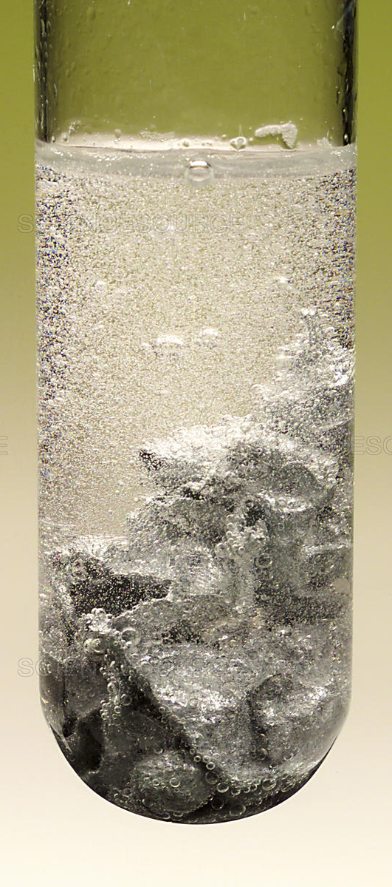
Daily Review
Writing Word Equations
Identify the reactants in the reaction and write them first, with plus signs between each one
Write an arrow at the end of the reactants
Identify the products in the reaction and write them after the arrow, with plus signs between each one
Nitric acid is poured over zinc metal. It produces zinc nitrate and bubbles of hydrogen gas.
Nitric acid + Zinc
Zinc nitrate+ Hydrogen
→

Slide 3
Daily Review
CFU 1
Rewrite the equation at the bottom of the slide. Put a circle around each of the coefficients and a box around each of the subscripts.
Balancing Formula Equations
To balance an equation a number is written before a chemical formula.
This is called a coefficient.
The coefficient shows how much of each substance is needed.
2 HCl + Mg → MgCl₂ + H₂
The coefficient in front of HCl means there are 2 HCl molecules for each magnesium atom.
4 Al + 3 O₂ → 2 Al₂O₃

Slide 4
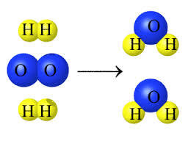
Daily Review
Balancing Formula Equations
List the number of each type of element on both sides of the equation.
Choose an element that has unequal numbers
Add coefficients to make them equal and adjust the numbers of elements in the list.
Choose another element that has unequal numbers, add coefficients and adjust the list.
Continue until all elements have equal numbers.
Oxygen + Hydrogen → Water
O₂ + H₂ → H₂O
2
2
O = 2
H = 2
O = 1
H = 2
2
4
4

Slide 5
Daily Review
Balancing Formula Equations
List the number of each type of element on both sides of the equation.
Choose an element that has unequal numbers
Add coefficients to make them equal and adjust the numbers of elements in the list.
Choose another element that has unequal numbers, add coefficients and adjust the list.
Continue until all elements have equal numbers.
Aluminium + Chlorine → Aluminium chloride
Al + Cl₂ → AlCl₃
2
3
2
Al = 1
Cl = 2
2
Al = 1
Cl = 3
2
6
6

Slide 6
Acids and Bases Year 9 Science

Slide 7
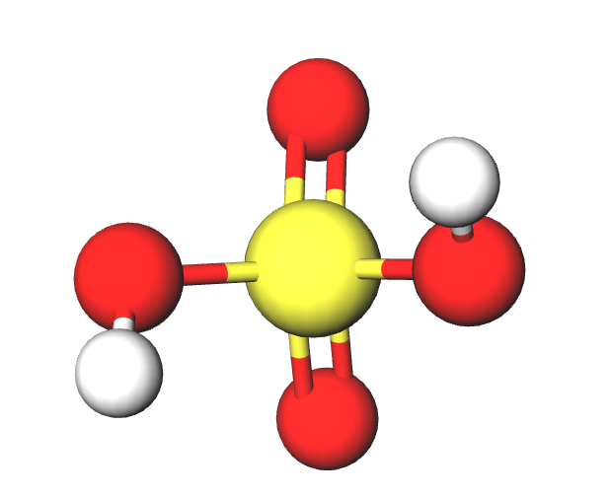
Learning Objectives
CFU
What are the two types of chemicals we are learning about?
Identify properties of acids and bases.
Describe uses of common acids and bases.
Activate Prior Knowledge
The chemical formula for some acids is shown below.
Hydrochloric acid HCl
Sulfuric acid H₂SO₄
Nitric acid HNO₃
Think, pair, share: What do the chemical formulae of these acids have in common?

Slide 8
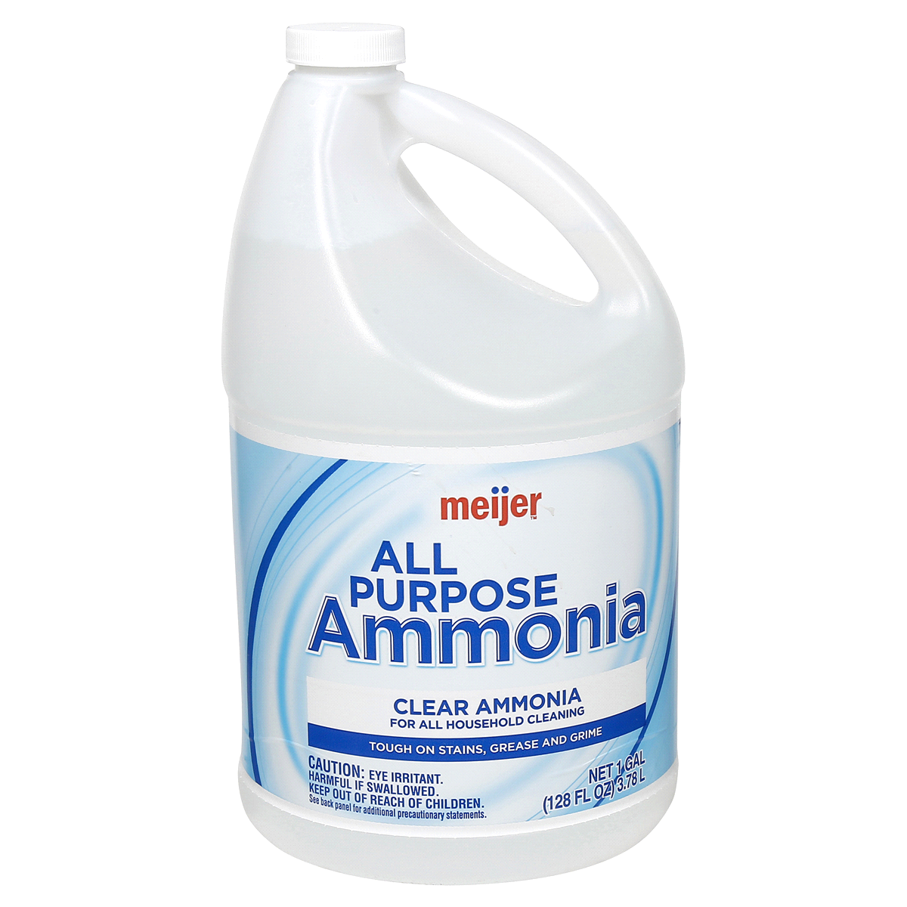
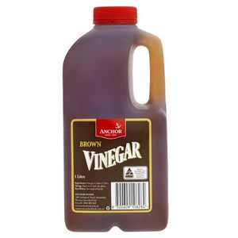
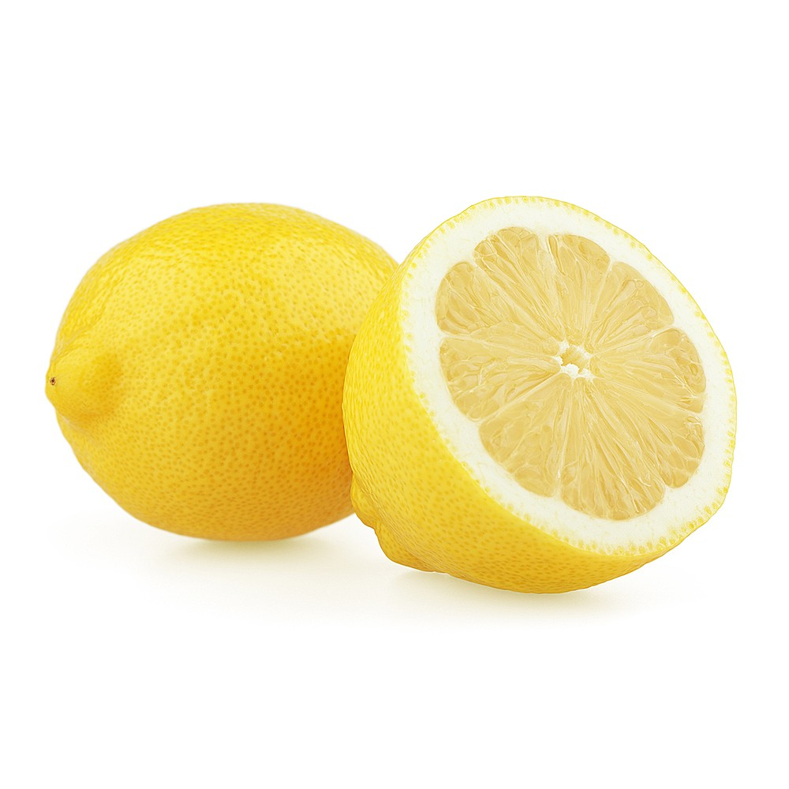
Concept Development
CFU 1
How are acids and bases grouped?
Acids and Bases
Acids and bases are groups of chemical compounds.
Each group has their own chemical properties.
Acids and bases have different uses, for example:
Acids are often used in cooking.
Bases can be used for cleaning and manufacturing other materials.
CFU 2
In your home, where might you find: An acid? A base?

Slide 9
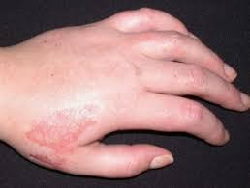
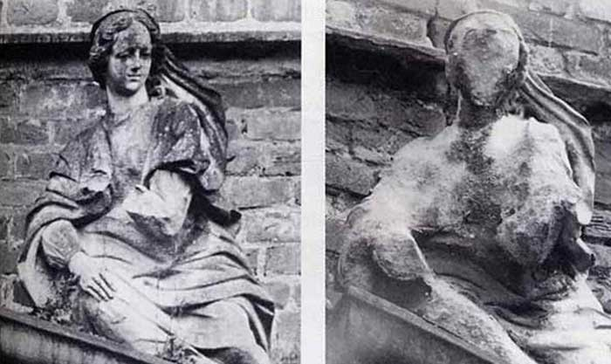
Concept Development
CFU 1
What are two common acidic foods?
Acids
Acids are a group of chemical compounds, which have similar properties.
The common properties of acids are:
They have a sour taste
They produce a prickling or burning sensation in contact with skin
They are corrosive (eat away at other substances)
Acids contain hydrogen (H) in their chemical structure.
CFU 2
Soft drinks contain carbonic acid. What can happen to your teeth if you drink too much soft drink?

Slide 10
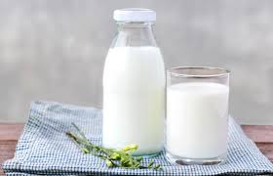
Concept Development
CFU 1
How are strong acids different to weak acids?
Acids
Acids can be strong or weak.
Strong acids are corrosive and can burn through objects.
Some strong acids are hydrochloric acid (HCl) in your stomach and nitric acid (HNO₃) used make fertilisers.
Weak acids are usually safer and often found in food.
Some weak acids are citric acid in citrus fruit and lactic acid found in dairy products.
CFU 2
Is vinegar a strong or a weak acid? Explain your choice.

Slide 11
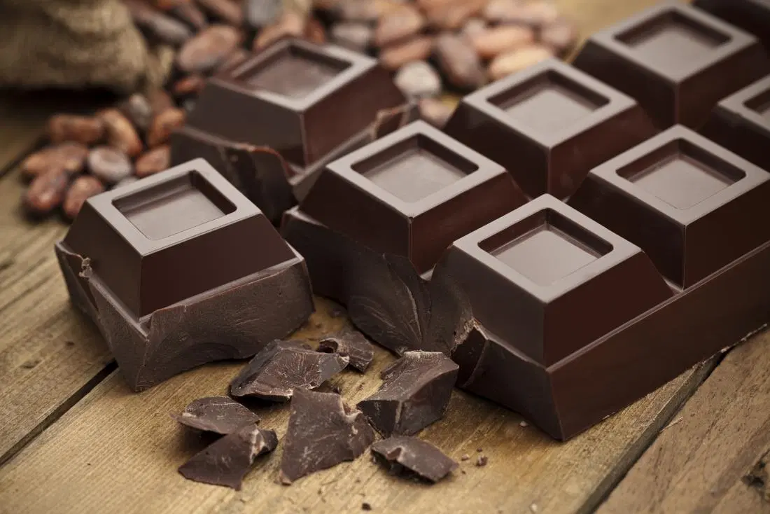
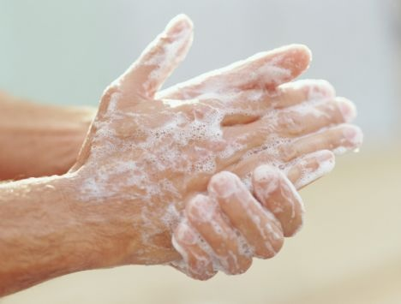
Concept Development
CFU 1
How are bases similar to acids?
Bases
Bases are a group of chemical compounds, which have similar properties.
The common properties of bases are:
They have a bitter taste
They feel slippery or soapy to touch
They are corrosive (eat away at other substances)
Many bases contain hydroxide (OH) or carbonate (CO₃) in their chemical structure.
CFU 2
What are two common foods that might contain bases? Why did you choose those foods?

Slide 12
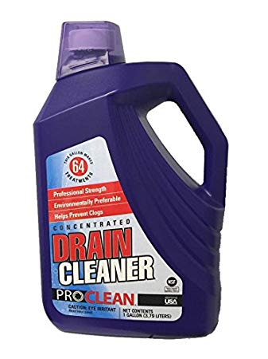
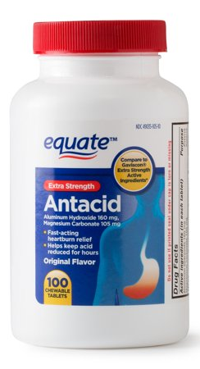
Concept Development
CFU 1
How are strong bases used?
Bases
Bases can be strong or weak.
Strong bases are corrosive and can burn through objects.
Some strong bases are sodium hydroxide (NaOH) found in drain cleaner and calcium hydroxide (Ca(OH)₂) used in concrete.
Weak bases are safer and often found in food or used as cleaning products.
Some weak bases are used as antacids and sodium carbonate (Na₂CO₃) in washing powders.
CFU 2
Calcium carbonate is another form of antacid. Is it a strong or a weak base? Explain your choice.

Slide 13
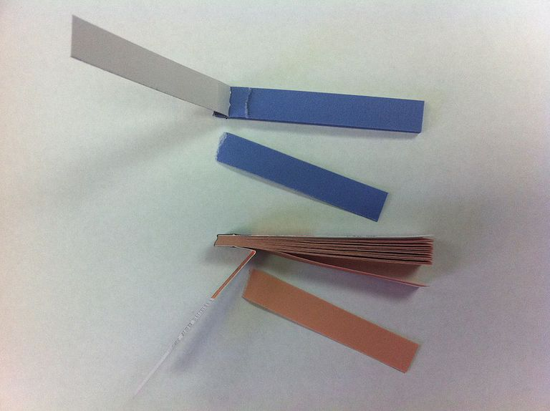

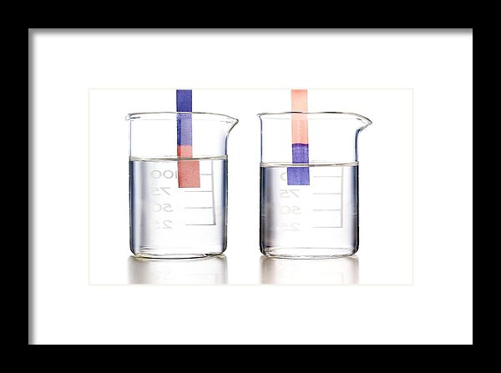
Concept Development
CFU 1
What is an indicator?
Identifying Acids and Bases Using Indicators
Indicator are chemicals that change colour in the presence of acids and bases.
A common indicator is litmus paper, which turns red in acids and blue in bases.
Many plant materials make good indicators. The colour of hydrangeas depends on how acidic or basic the soil is.
CFU 2
In the image below, which beaker contains the base and which contains the acid? Explain your choice.

Slide 14
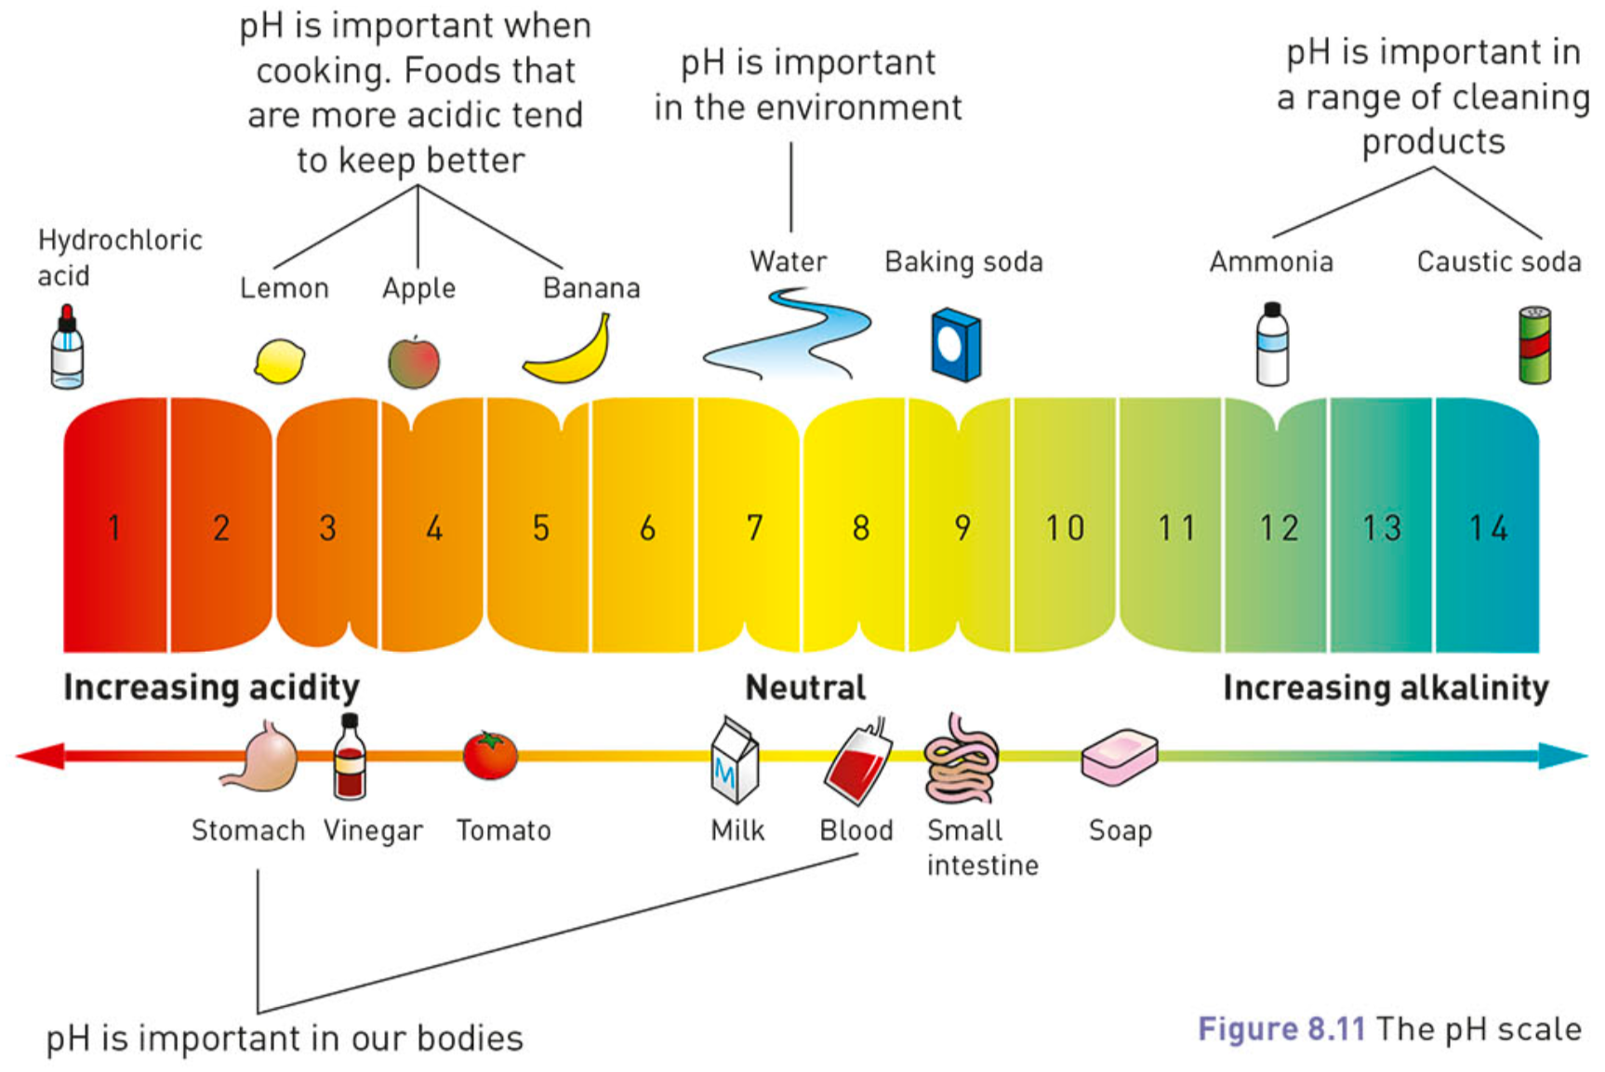
Concept Development
CFU 3
Is baking soda an acid or a base? How do you know?
CFU 1
How can we compare how acidic or basic substances are?
pH Scale and Universal Indicator
The pH scale is used to compare how acidic or basic different substances are.
If a substance is neutral, it has a pH of 7, for example pure water.
Acidic substances have a pH of less than 7.
A stronger acid has a lower pH.
Basic substances have a pH of more than 7.
A stronger base has a higher pH.
CFU 2
Which is more acidic, a lemon or a banana? Explain your choice.

Slide 15

Concept Development
CFU 1
What is universal indicator and what does it show?
pH Scale and Universal Indicator
Universal indicator is a mixture of indicators and can be used in solution or paper form.
It gives a more accurate indication of how acidic or basic a substance is.
Universal indicator changes colour depending on the pH of the substance and is compared to a colour chart.
CFU 2
What colour would a strong base show?

Slide 16
Skill Development / Guided Practice
Comparing Acids and Bases
Collect a worksheet and fill out the sheet using the information below.
Properties of Acids and Bases
Acids
Bases
Sour
Bitter
Cause prickling sensation
Corrosive
Feel soapy
Contain either hydroxide (strong) or carbonate (weak)
Contain hydrogen

Slide 17
Skill Development / Guided Practice
Comparing Acids and Bases
Collect a worksheet and fill out the sheet using the information below.
pH of Acids and Bases
Strong acid
Weak acid
Weak base
Strong base

Slide 18
Relevance
Acids and bases have a large variety of uses in our everyday lives.
Acids make food taste sour and bases can be used in cooking to make cakes rise
Bases are often used as household cleaning products
Antacids are bases that are taken to relieve indigestion
Acids are used to manufacture many materials and substances
The pH scale is used to make sure products like shampoo or moisturisers are not too acidic or basic for our skin.
It is also used to make sure the chemicals in swimming pools are at safe levels.

Slide 19
Skill Closure
Which of the following properties belongs to bases and which to acids?
Bitter taste Causes prickling sensation Sour taste Corrosive Feels soapy
Skill Closure
What is an indicator?
Skill Closure
On the pH scale, what range indicates a substance is:
Basic?
Acidic?
Neutral?

Slide 20
Independent Practice
Complete the rest of the “Acids and Bases” worksheet.

